Slide 1
Sustainability Strategy
Progress on cross-cutting sustainability initiatives
Date
16/11/2022

Slide 2


Transversal Sustainability Initiatives
Corporate and TGI 2022
INITIATIVES | TGI | PROGRESS (15/11/2022)
1. Design of a climate change strategy | Alignment with the corporate climate change strategy: Measurement and verification of GHG emissions. 2022-2030 emissions reduction plan. Compensation of emissions. | Alignment with the corporate climate change strategy: Decarbonization Route Progress (see detail slide 3) The selection and contracting process to measure fugitive emissions from 37% of the infrastructure is underway Kick off and interview construction path reduction emissions (Corporate) Emission compensation: Emission compensation for emergencies in 2021 (72,000 TCO2eq) Emission compensation for carbon neutrality of 5 locations (8,938TCO2eq)) Emission compensation for emergencies in the 1st semester of 2022 (33,888 TCO2eq)
2. Design and implementation of a human rights strategy / diversity and inclusion | Diversity and inclusion gap-closing plan. Inclusion of human rights clauses in the contracts. Evaluation of the performance of the contractors in Human Rights. | Launch of the Open Door Program in which we group lines of action with specific goals, putting women and vulnerable communities in the center. Some of the results are listed on slide 4. Human rights clauses were included in the contracts. The inclusion of the evaluation of the performance of contractors in Human Rights is in process in conjunction with GEB.

Slide 3
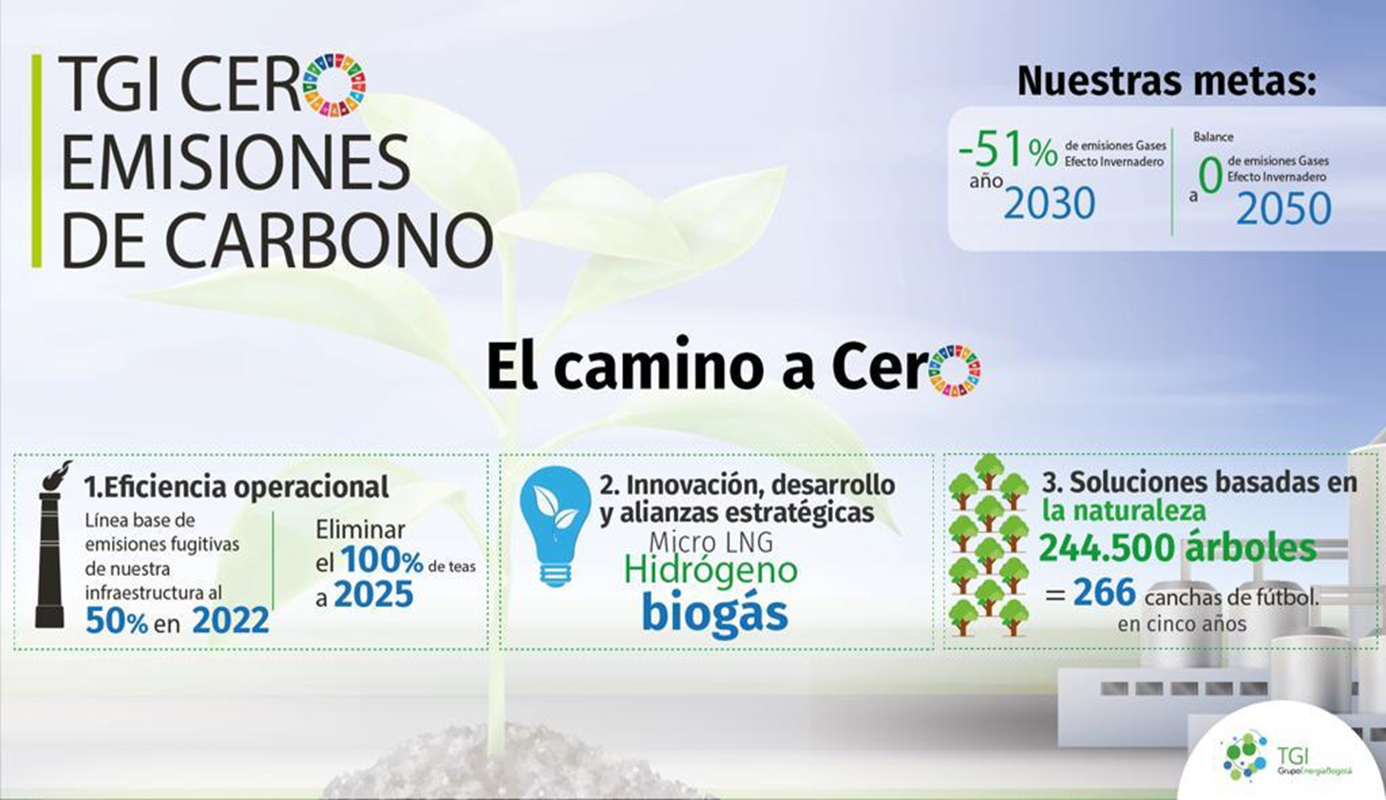







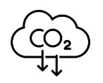



Decarbonization Route
Advances 2022
4
37% contract awarded for the inventory of fugitive emissions in the infrastructure.
4.025 trees planted which is equivalent to 3.80 Ha of Biological corridors
Feasibility study to implement local value chains through the production and use of . biogas in Bogotá and Barranquilla.
6 emission reduction projects in operational efficiency and sustainable mobility
5 offices in process to certify Neutral Carbon with the compensation of 8.938 TCO2eq
Study for the production of biogas and organic fertilizers in rural areas using biodigester
78% of advance in tightening and adjustment plan
72.000 TCO2eq offset by certified carbon credits
Gastrack Kandeo project (financing of up to 4.000 und. dedicated to natural gas).
100% Carbon footprint verification 2021.
Beekeeping project, as a strategy of conservation and productive reconversion in the Lengupá province
10 Certified facilities in energy efficiency.
Hydrogen Route Construction
5.391 individuals prohibited from monitoring and maintenance in the municipalities of Puente Nacional, La Belleza, Vasconia, Miraflores, Yondó, La Tebaida.
Kick Off and interview for the construction of a reduction path and GHG emissions management plan.
Biogas Route Construction
Notes:
6 proyectos
Eficiencia operacional:
Sistema de compresión portátil para reempacar el gas y no ventear en trabajos en frío
Sistema de tea portátil para quemar gas en lugar de emitir
Sistema de tea apagado en las estaciones de comprensión
Sistema de paneles solares en las estaciones compresoras
Programa de mantenimientos programados para disminuir la cantidad de gas que se libere antes de realizar el mantenimiento. Con esta estrategia se evitarán emisiones las cuales serán contabilizadas como emisiones evitadas.
Plan de apriete y ajuste de las emisiones fugitivas medidas en el 2021 y las medidas en el 2022
Movilidad Sostenible:
7. Proyecto Gastrack Kandeo (financiación de hasta 4.000 und dedicados a gas natural para carga en 3 años, la sustitución de 4.000 camiones de carga de Diésel a GNV permitirá una reducción de 327.294 toneladas de emisiones de CO2 al año)
Plan de movilidad sostenible en colaboradores / Cambiar el 100% de la flota vehicular a GNV, bien sea por la conversión o compra para sustitución (validar con Gunnar)
Economía Circular:
Proyecto piloto residuos en puente nacional
Proyecto piloto residuos en miralores

Slide 4
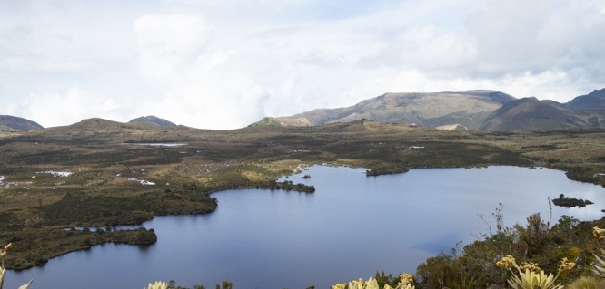
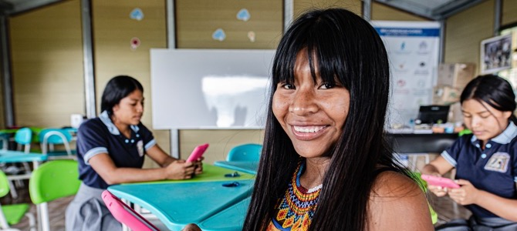
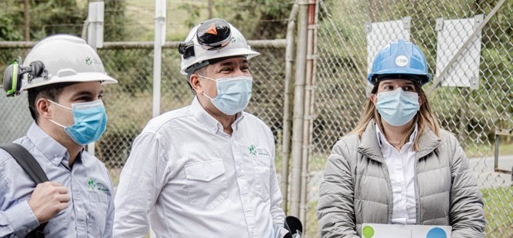




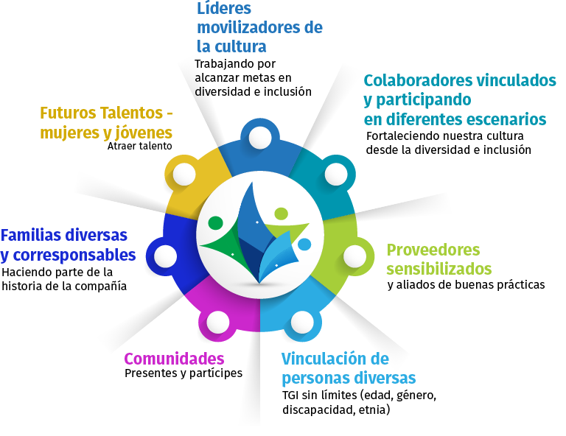
We are an Open Door company
ADVANCES IN TGI 2022
50% women in senior management
40% women in middle management
10% women/youth in operational positions
5% ethnic/racial minorities
2% people with disabilities
3% LGBTQ+
PROGRESS IN TERRITORY 2022
Signing and beginning of the training process for 200 women and support for 30 enterprises.
20 registered TGI Mentors and/or volunteers
17% of workers in the territory are women 7 Impacted Territorial Units (Guajira / Meta)
Notes:
Por eso desde TGI fijamos nuestras metas de sostenibilidad en tres dimensiones, haciendo del gas natural la principal herramiena:
Ambiental: con una meta para reducción de emisiones GEI para llegar a ser balance 0 en 2050.
Eficiencia operacional
Innovación y desarrollo: Soluciones de energía como biogás, micro LNG e H2
Soluciones basadas en la naturaleza
Social
Crecimiento y desarrollo de los territorios mediante inversión social en educación, género y gasificación rural.
Gestión y diversidad del capital humano y la seguridad en el trabajo (leer metas)
Gobierno
Relaciones constructivas y colaborativas con entes regulatorios y de gobierno
Derechos Humanos y Debida Diligencia
Somos conscientes que los retos sociales y ambientales nos imponen avanzar de manera decidida y acelerada, mediante el establecimiento de alianzas estratégicas, diálogo permanente en los territorios, y la innovación como centro para el logro de un transición energética justa.

Slide 5
Transversal Sustainability Initiatives
Corporate and TGI 2022
INITIATIVES | TGI | PROGRESS (15/11/2022)
3. Development of tools for environment management | Regulation of socio-environmental investment. Strengthen local suppliers in the areas of influence. | Contract signing and act of initiation in work for the process of training women leaders and entrepreneurs in the areas of influence. Includes service providers. On November 30, the strategy is launched, and the participants are selected.
4. Strengthening of environmental management systems | 1. Keep the ISO 14001 cert. | ISO 14001 Integrated Management System recertification without findings (March 2022). Recertification (5 Offices) and certification in 5 new offices in ISO 50001.

Slide 6
VOLUNTEERING TGI
Activity: Planting of native trees to care for the Quebrada de la Vereda Robles, Montes Sector in Puente Nacional Santander
Date: August 24
Educational Activity: Eco-Crafts Workshop and Environmental Education
Allies: Municipal Mayor's Office / Rural School Vereda Montes / Community Action Board (in management Min Ambiente Escuela SAVIA)
Time Bank of TGI collaborators (more than 50 registered and 30 in leadership school)
mentoring
TGI Leadership School Trainer
Activity: Beautification with art and recycling in Casacará- Agustín Codazzi, Cesar
Date: November 4
Educational Activity: Day of reading aloud and endowment of a collection of texts for the library Allies: Mayor of Agustín Codazzi, JAC.
Activity: Day to improve the children's playground and community recreation in Vereda Nazaret in Otanche, Boyacá
Date: December 16
Educational Activity: Values and sport, traditional games and micro-soccer championship
Allies: Otanche City Hall / JAC
2

Slide 7





Transversal Sustainability Initiatives
Corporate and TGI 2022
Iniciativa | TGI | AVANCES (15/11/2022)
5. Strengthening of sustainability management reports | Preparation of the 2022 Sustainability Report under the GRI standard. Preparation for external assurance of the report in 2022. | On October 31, a contract was signed with PWC for the sustainability report preparation . The indicators that will integrate the sustainability report for external assurance, are being defined and will be in charge of Corporate.
6. Communications strategy development | Strengthening of digital channels. Preparation of a content calendar with campaigns for social networks. Implementation of the work plan to strengthen the connection with GEB. Sustainability workshops. | In December, a sustainability awareness workshop will be held for TGI sustainability champions and developed by PWC.
26.762
670
215
7,9%%
42%
83
92%
193%
100%

Slide 8

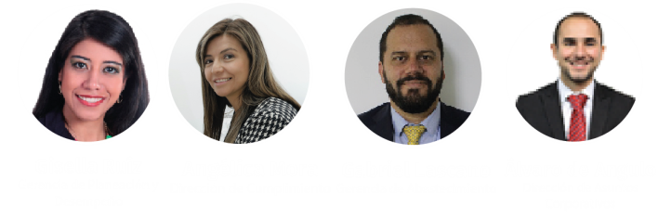
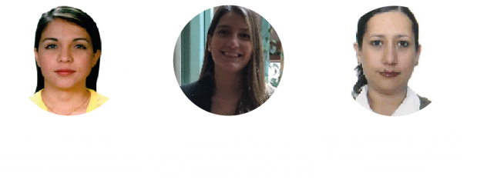







Governance and Economic Dimension
Environmental
Dimension
Social
Dimension
Communications

Slide 9
For restricted use GRUPO ENERGIA BOGOTA S.A. ESP. and its subsidiaries. All rights reserved. No part of this presentation may Be reproduced or used in any form by any means without permission explicit from GRUPO ENERGIA BOGOTAS.A. ESP. or its affiliates as property information fees.

